Slide 1
ML LAB Assignment 3
Name: Swapnil Ghosh
Roll: 001911001067
DEPT: IT
Year: 4th

Slide 2
PART 1

Slide 3
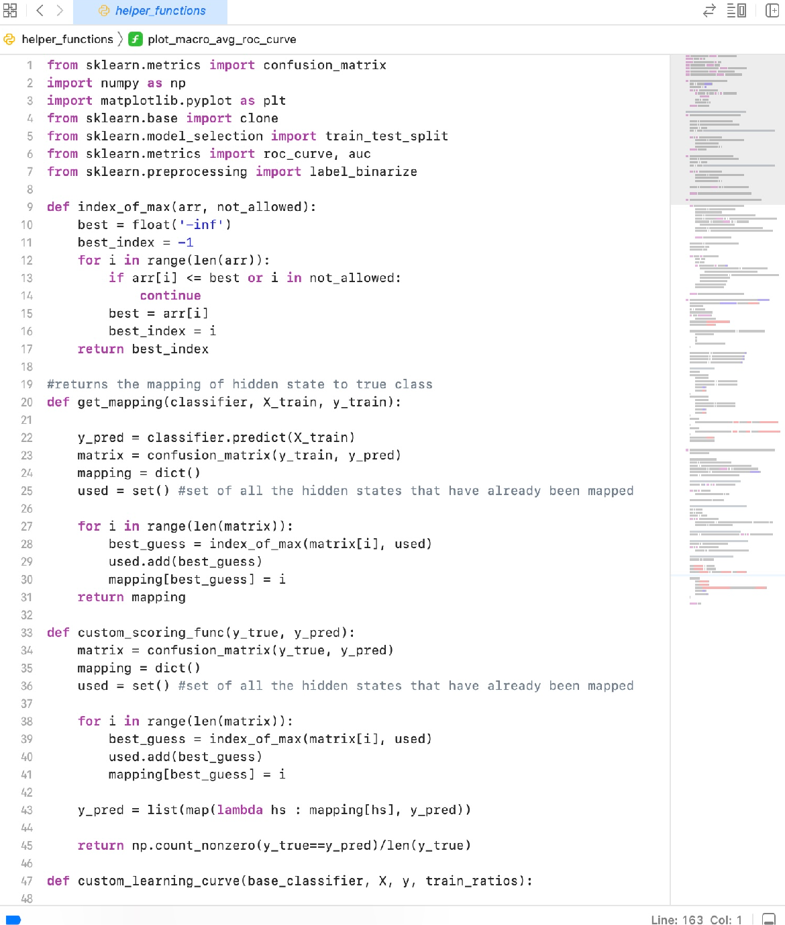
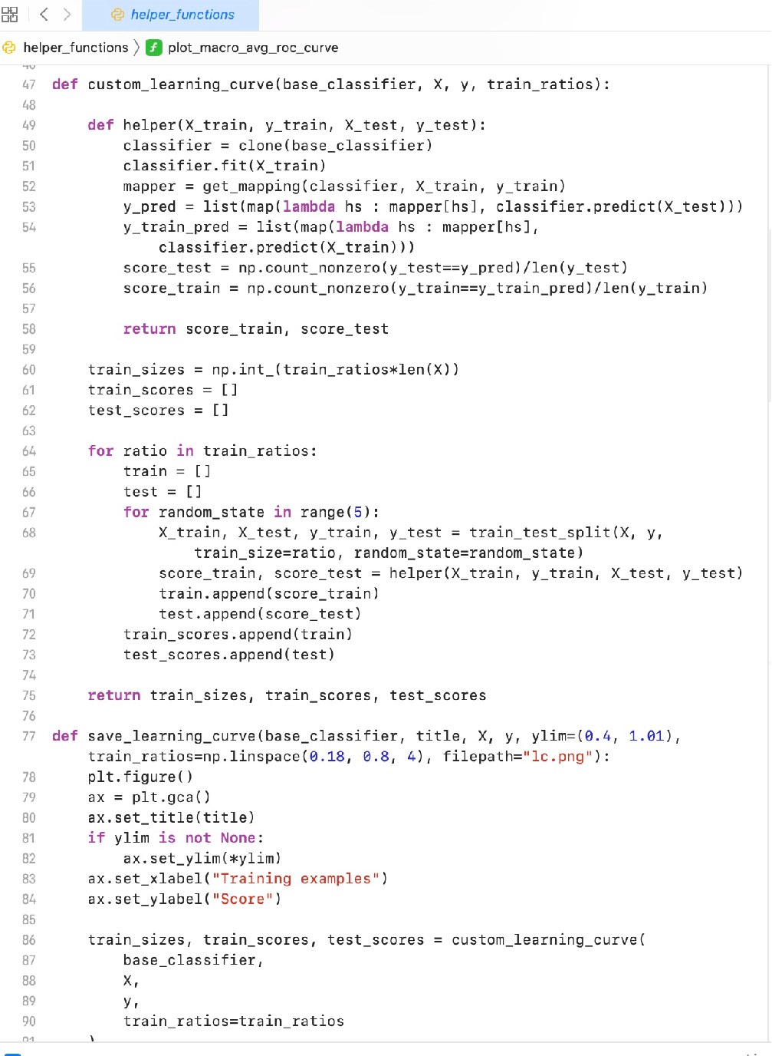
HELPER FUNCTIONS 1 -

Slide 4
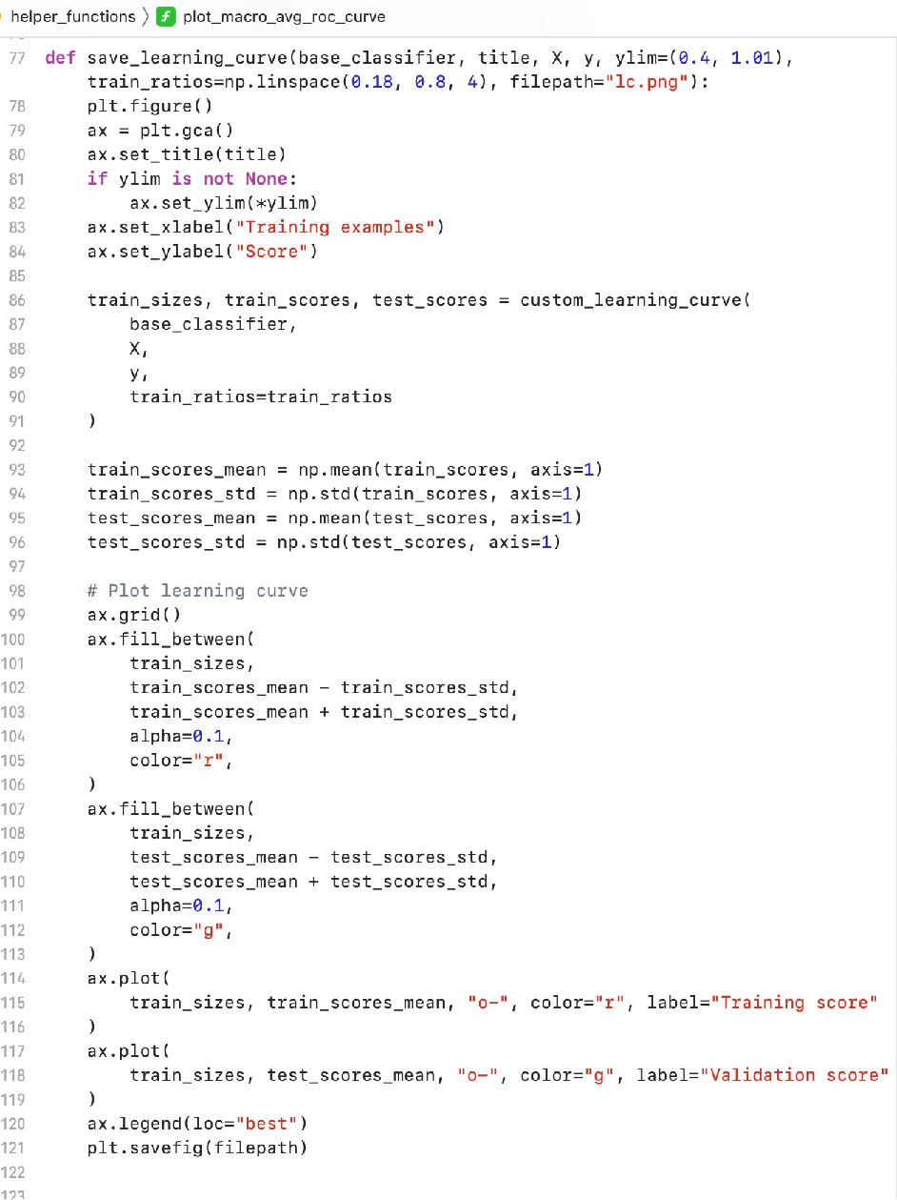
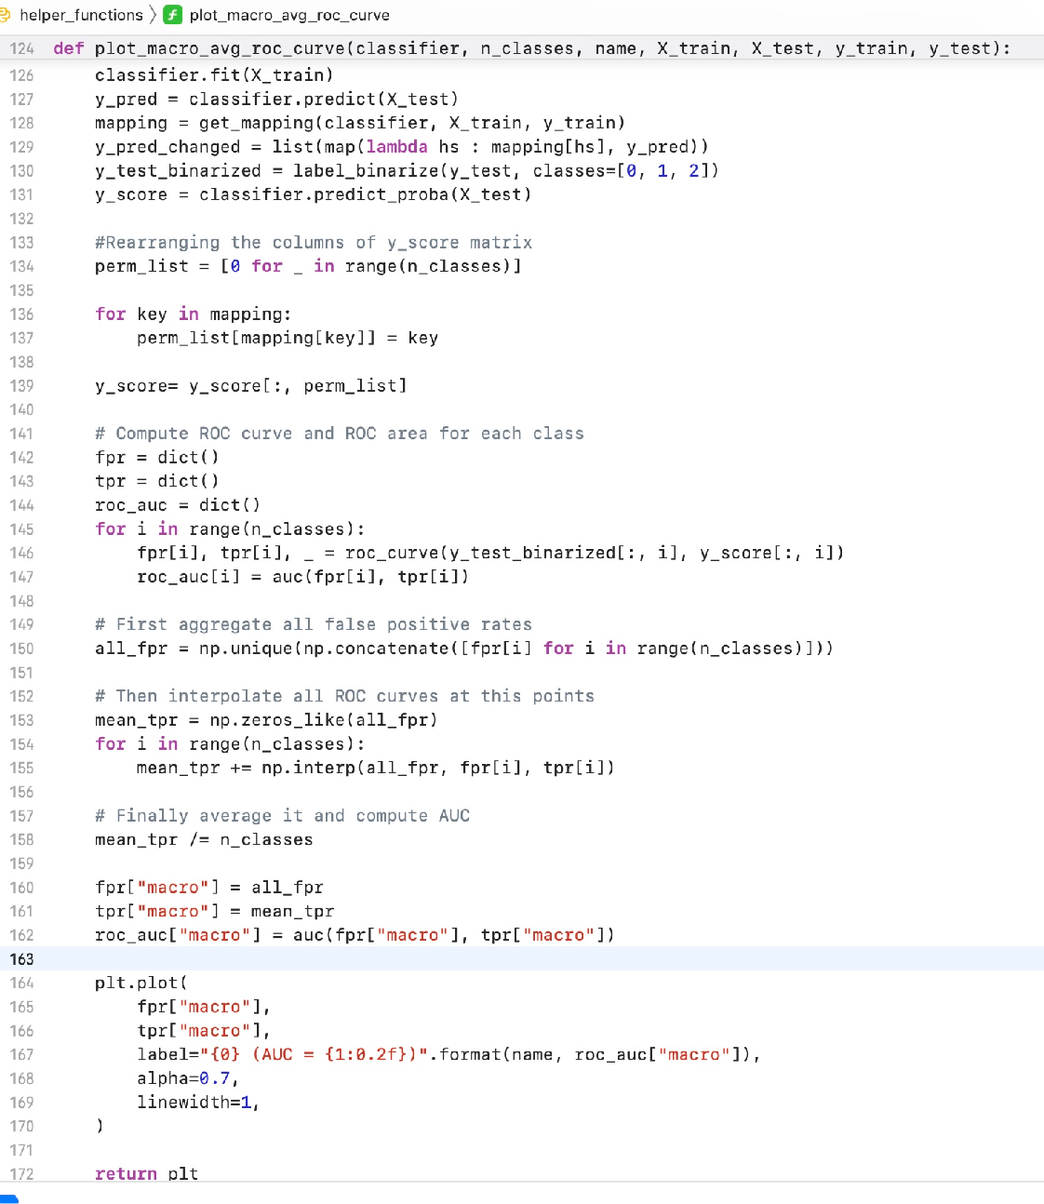
HELPER FUNCTIONS 2 -

Slide 5
WINE - CLASSIFICATION

Slide 6
GAUSSIAN HMM

Slide 7
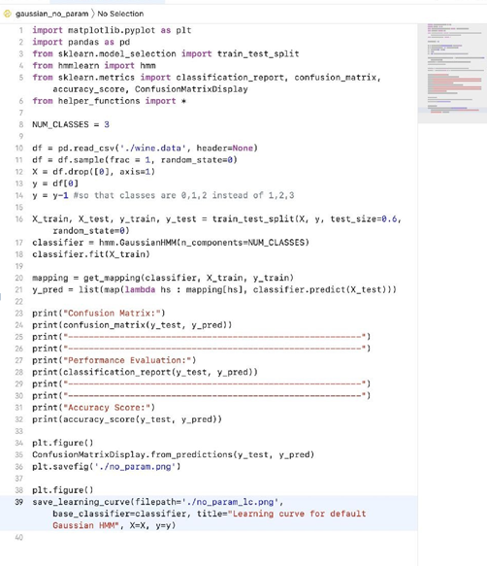
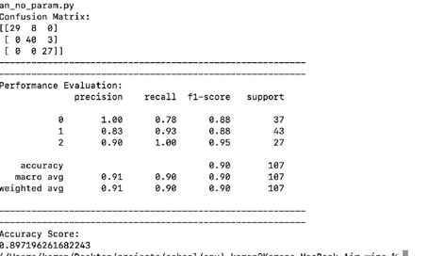
GAUSSIAN HMM (NO PARAMETER TUNING)- CODE & EVALUATION

Slide 8
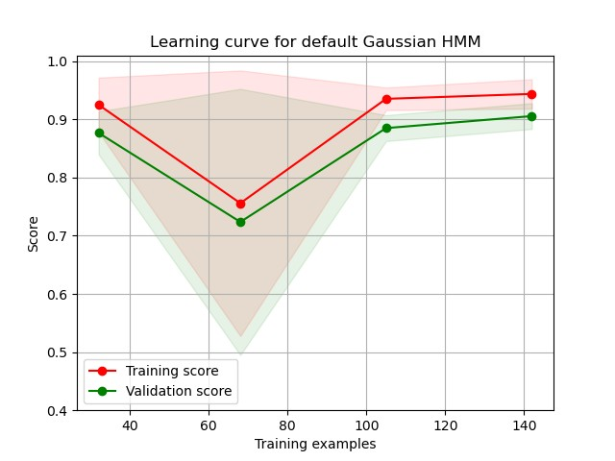
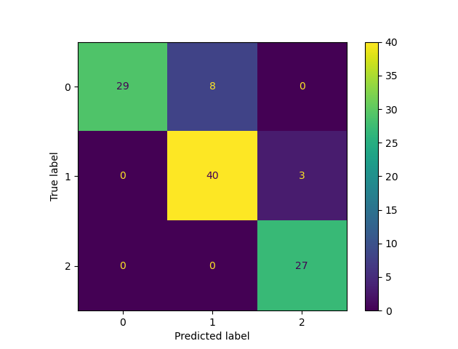
GAUSSIAN HMM (NO PARAMETER TUNING)- CONFUSION MATRIX AND LEARNING CURVE

Slide 9
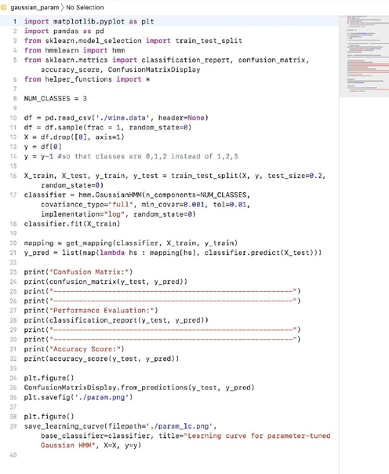
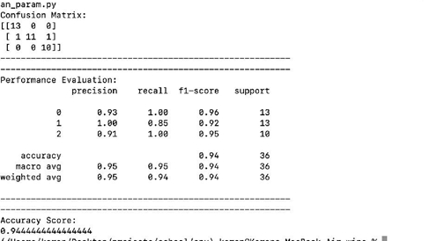
GAUSSIAN HMM (WITH PARAMETER TUNING)- CODE & EVALUATION

Slide 10
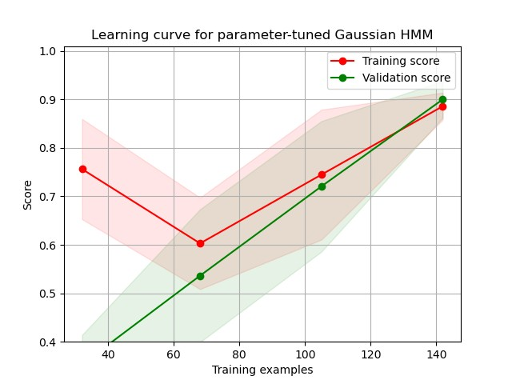
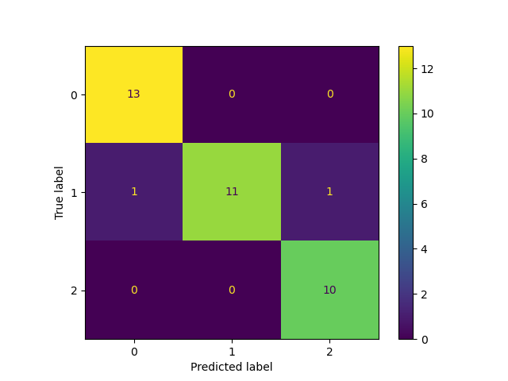
GAUSSIAN HMM (WITH PARAMETER TUNING)- CONFUSION MATRIX AND LEARNING CURVE
CONFUSION MATRIX HeatMap

Slide 11
HMM WITH GAUSSIAN MIXTURE MODEL EMISSIONS

Slide 12
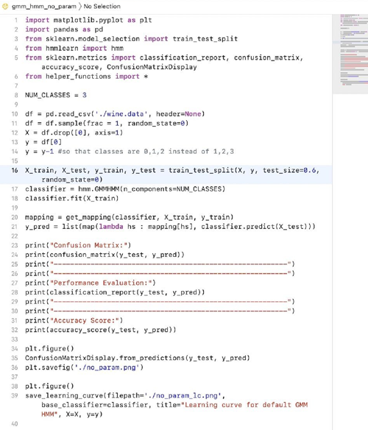
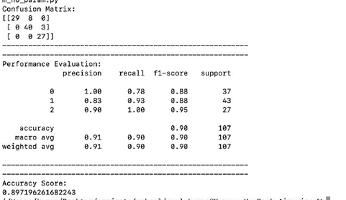
GMM HMM (NO PARAMETER TUNING)- CODE & EVALUATION

Slide 13


GMM HMM (NO PARAMETER TUNING)- CONFUSION MATRIX AND LEARNING CURVE

Slide 14
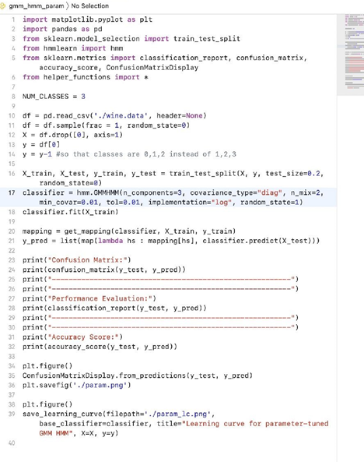
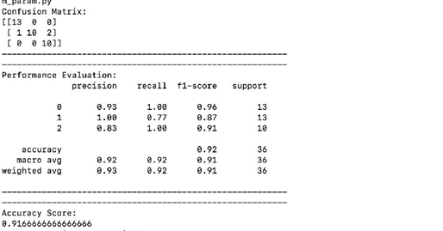
GMM HMM (WITH PARAMETER TUNING)- CODE & EVALUATION

Slide 15
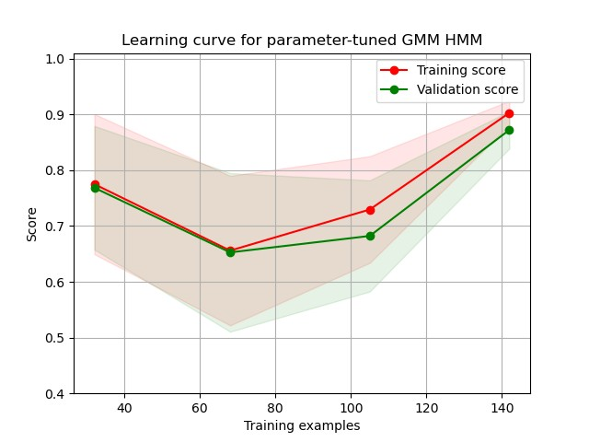
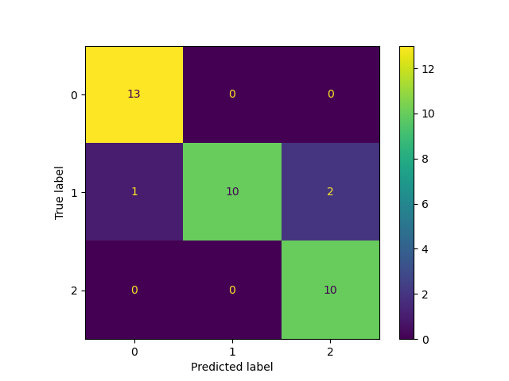
GMM HMM (WITH PARAMETER TUNING)- CONFUSION MATRIX AND LEARNING CURVE
CONFUSION MATRIX HeatMap

Slide 16
COMPARISON BETWEEN GAUSSIAN HMM AND GMM HMM.

Slide 17
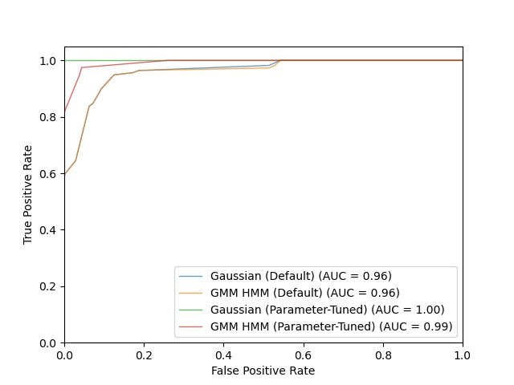
ROC CURVES AND AUC COMPARISON

Slide 18
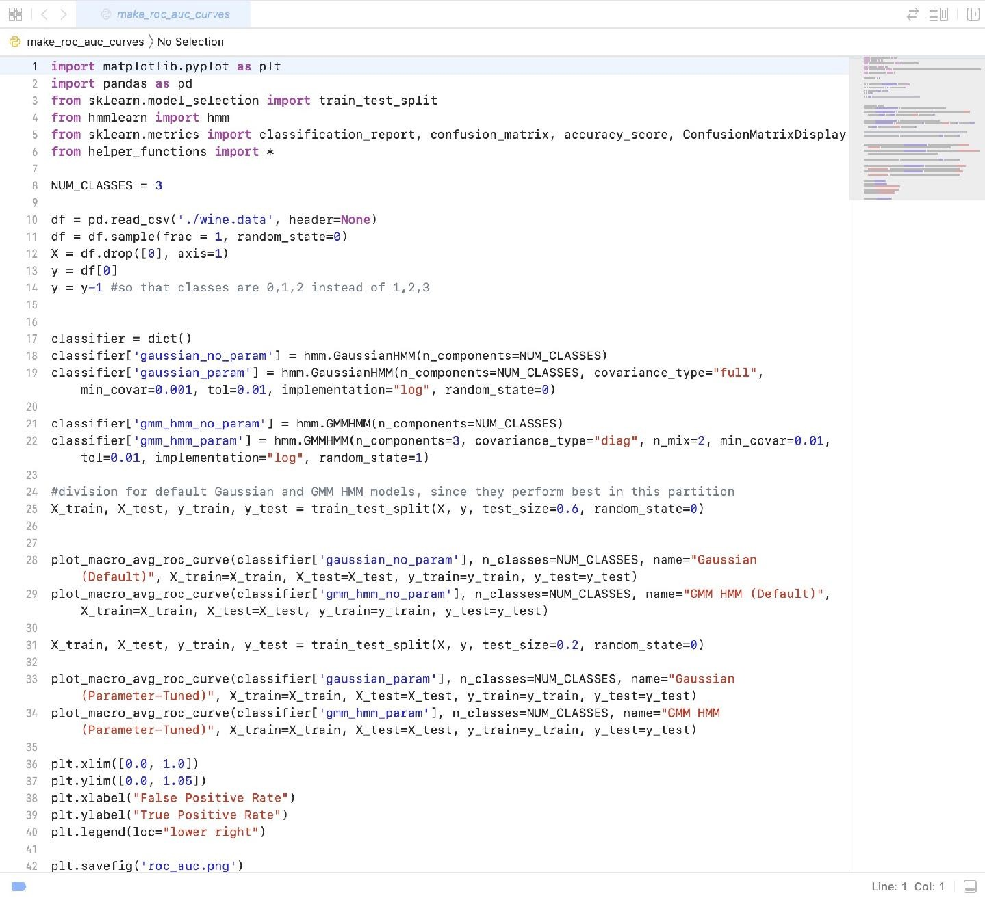
ROC CURVES AND AUC COMPARISON - CODE

Slide 19
COMPARISON OF PERFORMANCE
CLASSIFIER |  | Accuracy | P ec | Recall | F -Sco | AUC
GAUSSIAN HMM | DEFAULT | 0.93 | 0.93 | 0.93 | 0.93 | 0.96
 | TUNED | 0.94 | 0.95 | 0.94 | 0.94 | .00
GMM HMM | DEFAULT | 0.90 | 0.9 | 0.90 | 0.90 | 0.96
 | TUNED | 0.92 | 0.93 | 0.92 | 0.9 | 0.99

Slide 20
IONOSPHERE - CLASSIFICATION

Slide 21
GAUSSIAN HMM

Slide 22

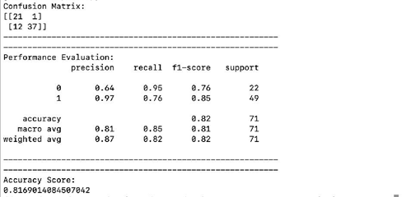
GAUSSIAN HMM (NO PARAMETER TUNING)- CODE & EVALUATION

Slide 23
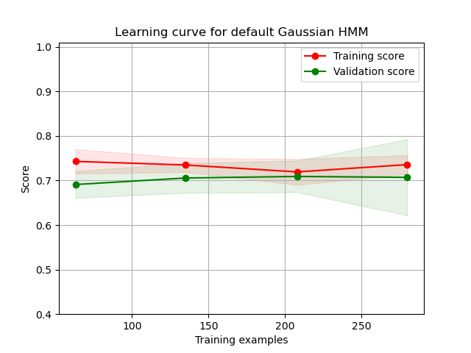
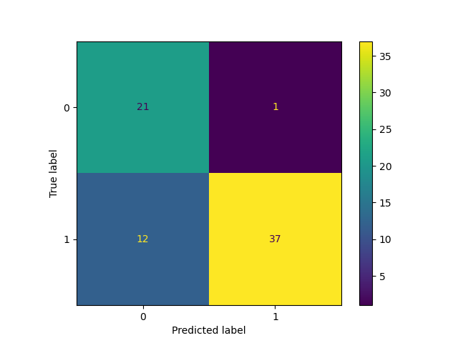
GAUSSIAN HMM (NO PARAMETER TUNING)- CONFUSION MATRIX AND LEARNING CURVE

Slide 24
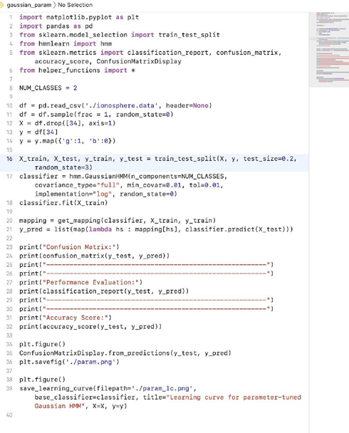
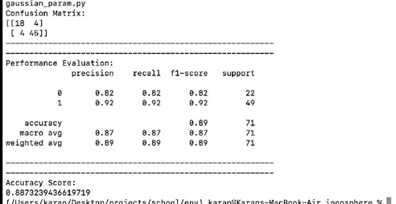
GAUSSIAN HMM (WITH PARAMETER TUNING)- CODE & EVALUATION

Slide 25
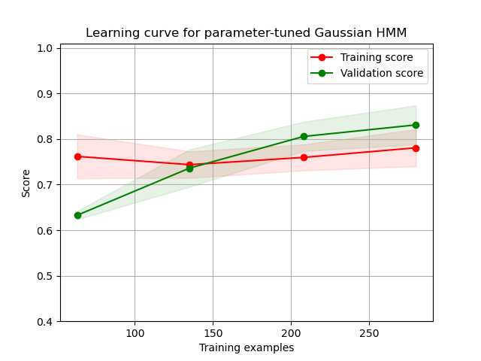
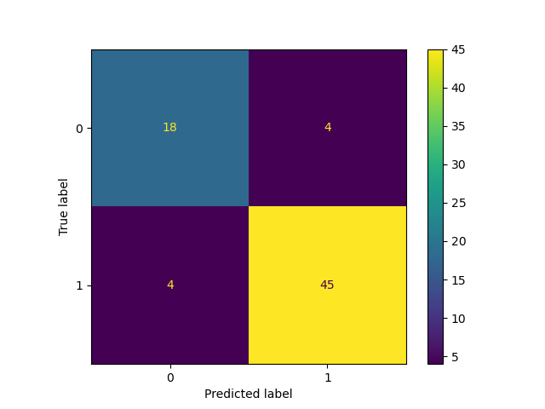
GAUSSIAN HMM (WITH PARAMETER TUNING)- CONFUSION MATRIX AND LEARNING CURVE
CONFUSION MATRIX HeatMap

Slide 26
HMM WITH GAUSSIAN MIXTURE MODEL EMISSIONS

Slide 27
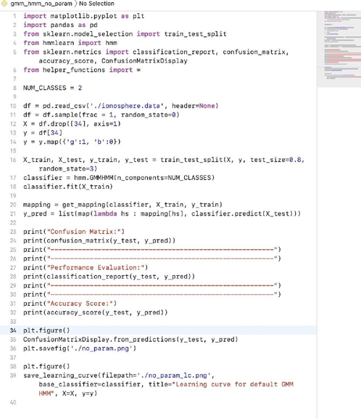
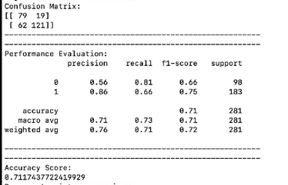
GMM HMM (NO PARAMETER TUNING)- CODE & EVALUATION

Slide 28
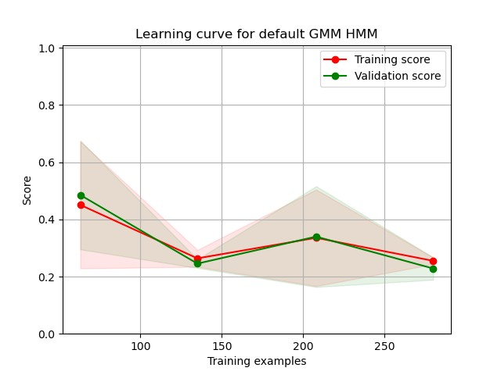

GMM HMM (NO PARAMETER TUNING)- CONFUSION MATRIX AND LEARNING CURVE

Slide 29
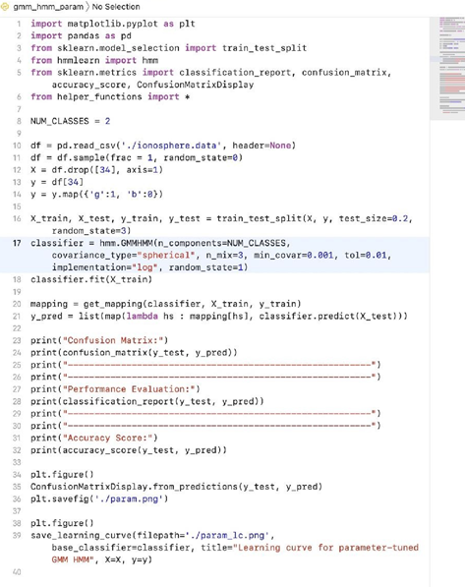
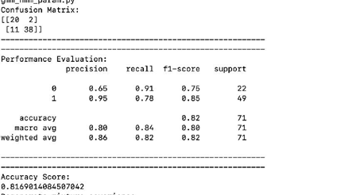
GMM HMM (WITH PARAMETER TUNING)- CODE & EVALUATION

Slide 30
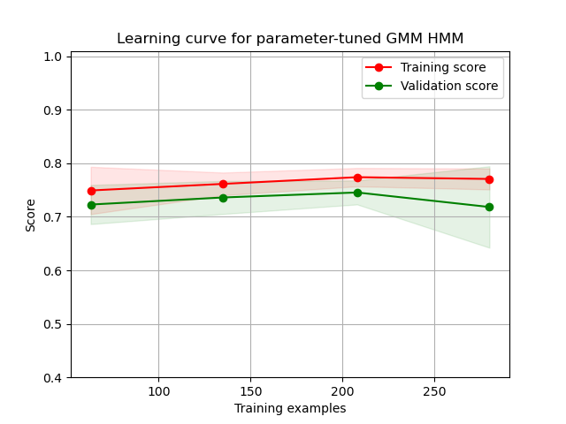

GMM HMM (WITH PARAMETER TUNING)- CONFUSION MATRIX AND LEARNING CURVE
CONFUSION MATRIX HeatMap

Slide 31
COMPARISON BETWEEN GAUSSIAN HMM AND GMM HMM.

Slide 32
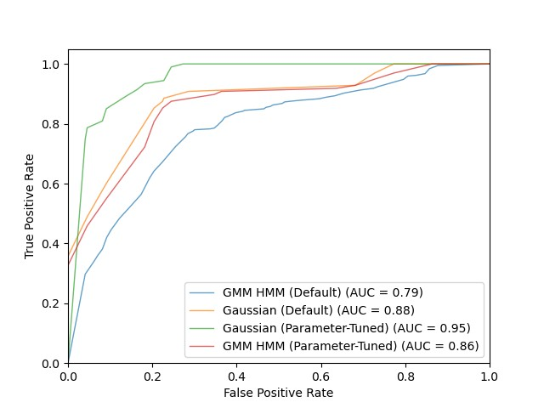
ROC CURVES AND AUC COMPARISON

Slide 33
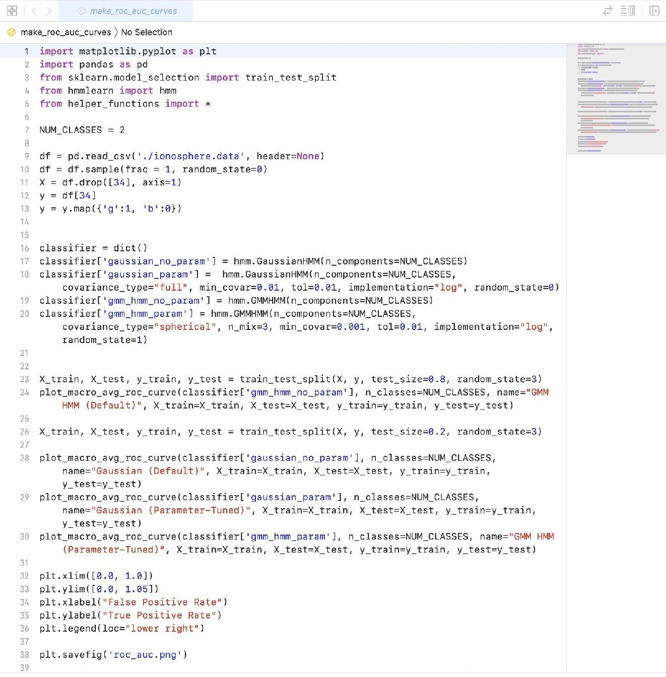
ROC CURVES AND AUC COMPARISON - CODE

Slide 34
COMPARISON OF PERFORMANCE
CLASSIFIER |  | Accuracy | P ec | Recall | F -Sco | AUC
GAUSSIAN HMM | DEFAULT | 0.82 | 0.87 | 0.82 | 0.82 | 0.88
 | TUNED | 0.89 | 0.89 | 0.89 | 0.89 | 0.95
GMM HMM | DEFAULT | 0.7 | 0.76 | 0.7 | 0.72 | 0.79
 | TUNED | 0.82 | 0.86 | 0.82 | 0.82 | 0.86

Slide 35
WISCONSIN BREAST CANCER - CLASSIFICATION

Slide 36
GAUSSIAN HMM

Slide 37
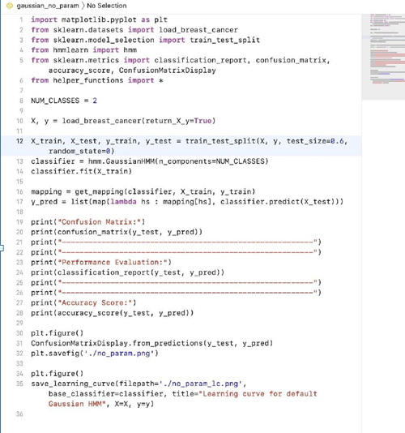
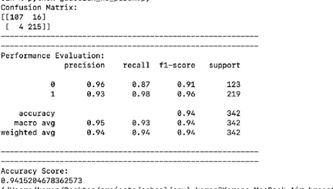
GAUSSIAN HMM (NO PARAMETER TUNING)- CODE & EVALUATION

Slide 38
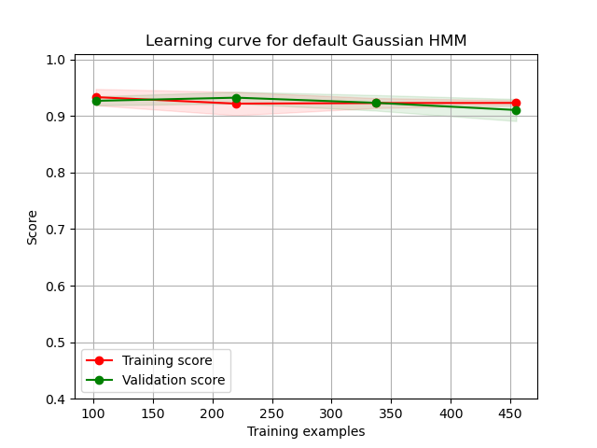

GAUSSIAN HMM (NO PARAMETER TUNING)- CONFUSION MATRIX AND LEARNING CURVE

Slide 39
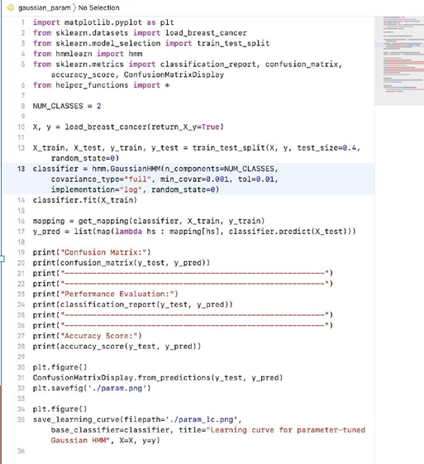
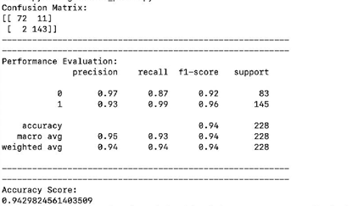
GAUSSIAN HMM (WITH PARAMETER TUNING)- CODE & EVALUATION

Slide 40
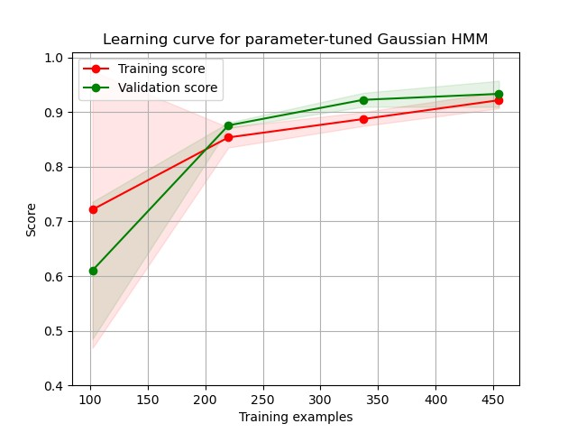

GAUSSIAN HMM (WITH PARAMETER TUNING)- CONFUSION MATRIX AND LEARNING CURVE
CONFUSION MATRIX HeatMap

Slide 41
HMM WITH GAUSSIAN MIXTURE MODEL EMISSIONS

Slide 42
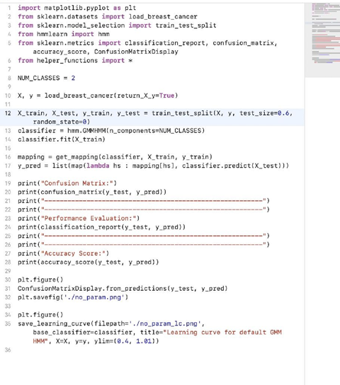
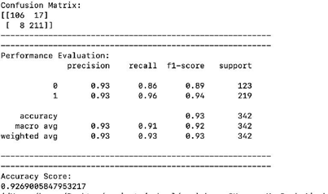
GMM HMM (NO PARAMETER TUNING)- CODE & EVALUATION

Slide 43
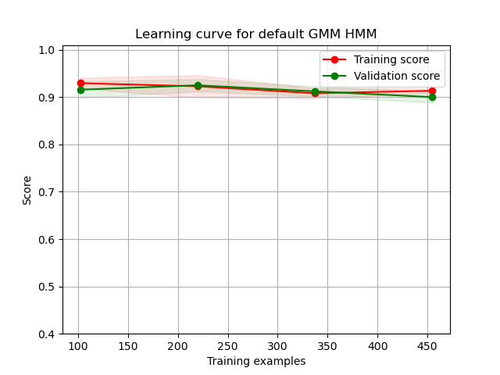

GMM HMM (NO PARAMETER TUNING)- CONFUSION MATRIX AND LEARNING CURVE

Slide 44
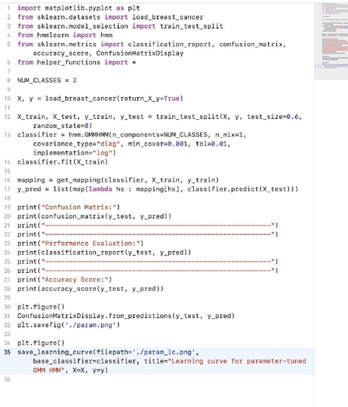
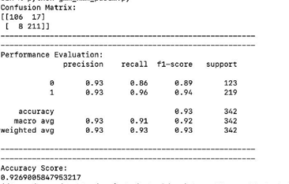
GMM HMM (WITH PARAMETER TUNING)- CODE & EVALUATION

Slide 45
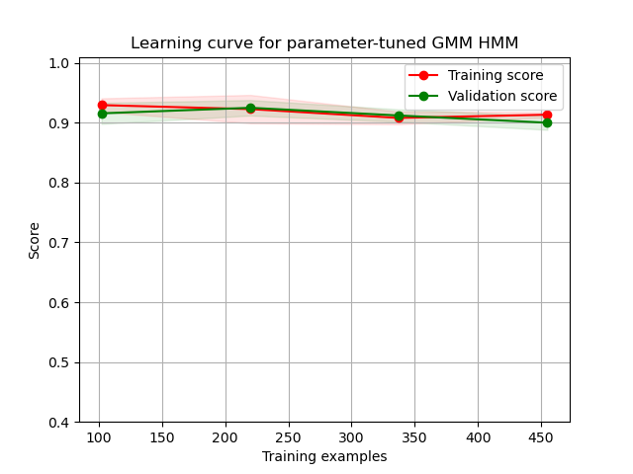
GMM HMM (WITH PARAMETER TUNING)- CONFUSION MATRIX AND LEARNING CURVE
CONFUSION MATRIX HeatMap

Slide 46
COMPARISON BETWEEN GAUSSIAN HMM AND GMM HMM.

Slide 47
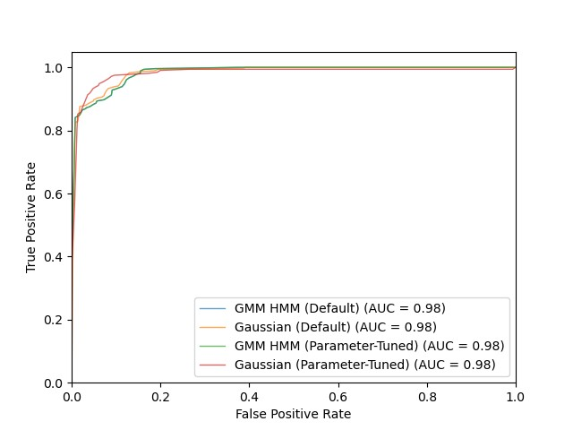
ROC CURVES AND AUC COMPARISON

Slide 48
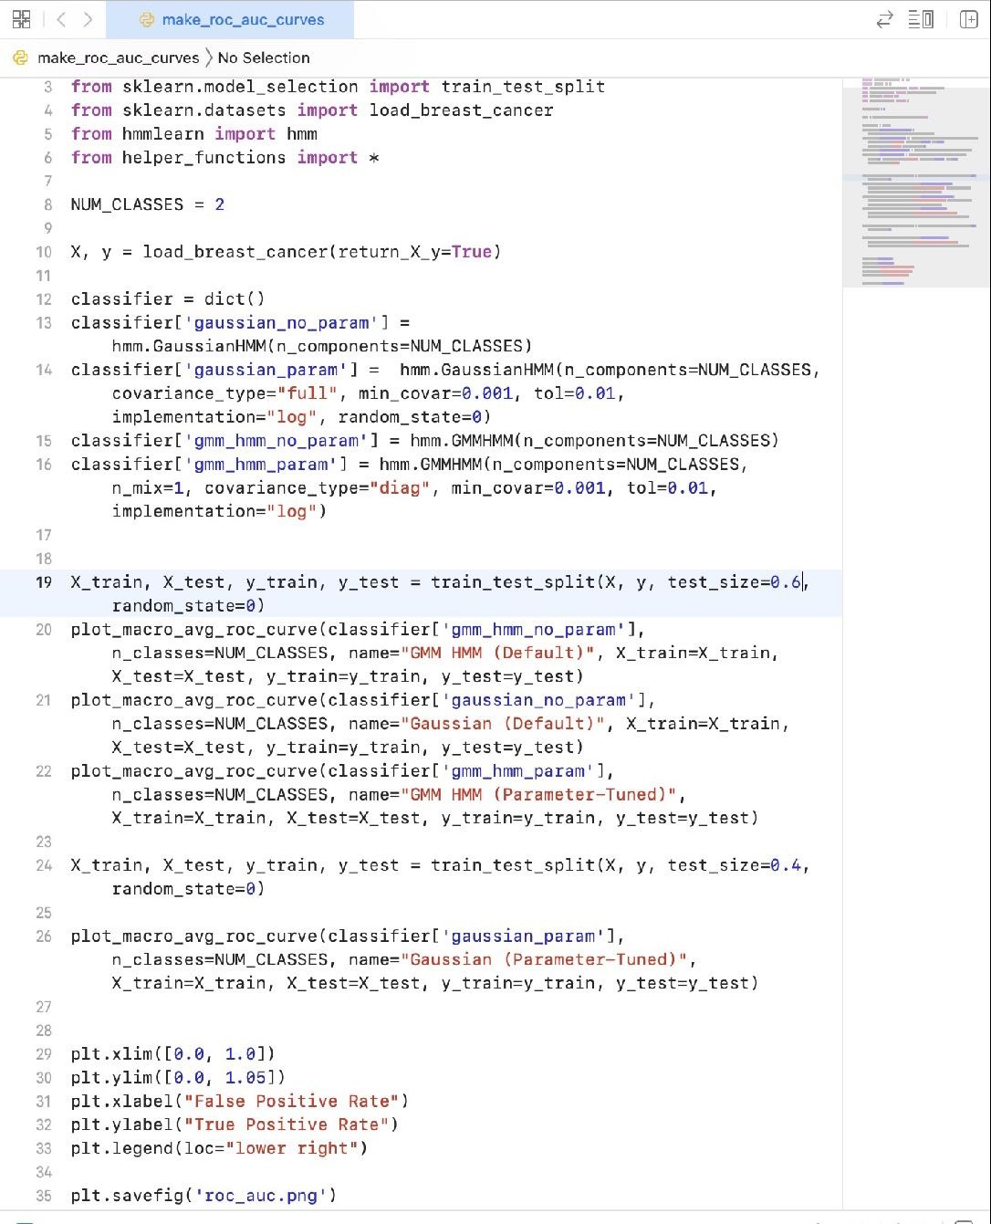
ROC CURVES AND AUC COMPARISON - CODE

Slide 49
COMPARISON OF PERFORMANCE
CLASSIFIER |  | Accuracy | P ec | Recall | F -Sco | AUC
GAUSSIAN HMM | DEFAULT | 0.94 | 0.94 | 0.94 | 0.94 | 0.98
 | TUNED | 0.94 | 0.94 | 0.94 | 0.94 | 0.98
GMM HMM | DEFAULT | 0.93 | 0.93 | 0.93 | 0.93 | 0.98
 | TUNED | 0.93 | 0.93 | 0.93 | 0.93 | 0.98

Slide 50
PART 2 , 3

Slide 51
CIFAR - CLASSIFICATION

Slide 52
CNN

Slide 53
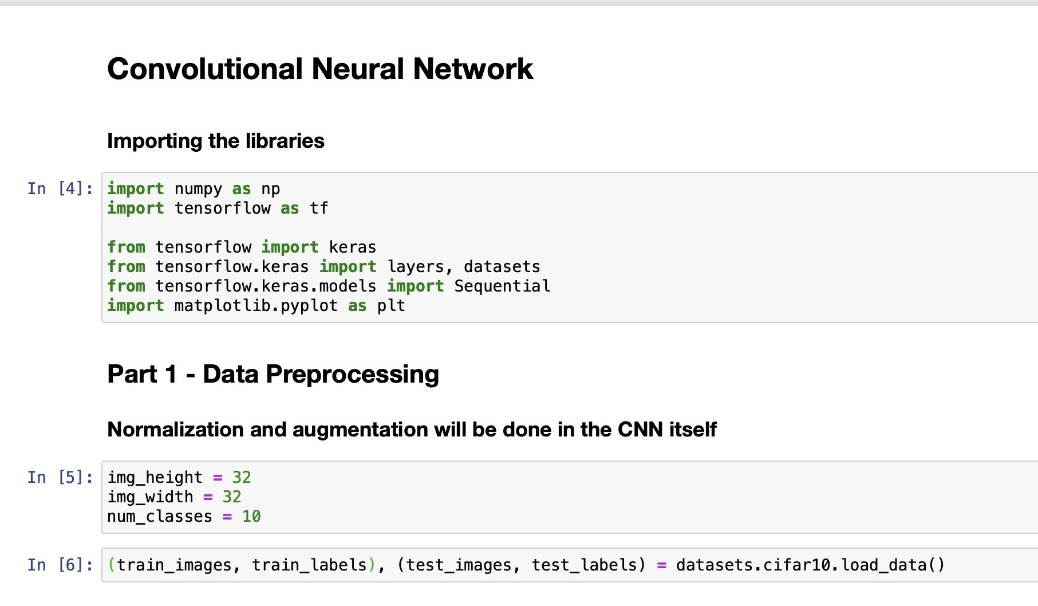
IMPORTS AND DATA PREPROCESSING

Slide 54

MODEL ARCHITECTURE

Slide 55

COMPILATION AND SUMMARY

Slide 56

TRAINING AND SAVING

Slide 57

TRAINING AND LOSS CURVES

Slide 58

PERFORMANCE - CODE

Slide 59


PERFORMANCE

Slide 60
VGG-16

Slide 61

IMPORTS, DATA PREPROCESSING & ARCHITECTURE

Slide 62

COMPILATION AND SUMMARY

Slide 63

TRAINING AND SAVING

Slide 64

TRAINING AND LOSS CURVES

Slide 65


PERFORMANCE

Slide 66
RESNET-50

Slide 67

IMPORTS, DATA PREPROCESSING & ARCHITECTURE

Slide 68

COMPILATION AND SUMMARY

Slide 69

TRAINING AND SAVING

Slide 70

TRAINING AND LOSS CURVES

Slide 71


PERFORMANCE

Slide 72
RNN (LSTM)

Slide 73

IMAGE PROCESSING AND MODEL ARCHITECTURE

Slide 74

COMPILATION AND SUMMARY

Slide 75

TRAINING AND SAVING

Slide 76

TRAINING AND LOSS CURVES

Slide 77


PERFORMANCE

Slide 78
ALEXNET

Slide 79

MODEL ARCHITECTURE - I

Slide 80

MODEL ARCHITECTURE - II

Slide 81

TRAINING AND SAVING

Slide 82

TRAINING AND LOSS CURVES

Slide 83


PERFORMANCE

Slide 84
GOOGLENET

Slide 85

IMPORTS, DATA PREPROCESSING AND INCEPTION MODULE

Slide 86

MODEL ARCHITECTURE

Slide 87

COMPILATION

Slide 88

TRAINING

Slide 89

TRAINING AND LOSS CURVES

Slide 90


PERFORMANCE

Slide 91
COMPARISON BETWEEN CNN, VGG-16, RESNET-50, LSTM(RNN), ALEXNET AND GOOGLENET.

Slide 92

ROC CURVES AND AUC COMPARISON

Slide 93

ROC CURVES AND AUC COMPARISON - CODE (I)

Slide 94

ROC CURVES AND AUC COMPARISON - CODE (II)

Slide 95
COMPARISON OF PERFORMANCE
CLASSIFIER | Accuracy | Precision | Recall | F1-Score | AUC
CNN | 0.72 | 0.73 | 0.72 | 0.72 | 0.96
VGG-16 | 0.86 | 0.87 | 0.86 | 0.86 | 0.99
RESNET-50 | 0.83 | 0.83 | 0.83 | 0.83 | 0.98
LSTM | 0.27 | 0.27 | 0.27 | 0.25 | 0.72
ALEXNET | 0.73 | 0.75 | 0.73 | 0.73 | 0.96
GOOGLENET | 0.76 | 0.78 | 0.76 | 0.76 | 0.97

Slide 96
CONCLUSION:
GoogleNet performed better than AlexNet which, in turn, performed better than a simpler CNN.This is expected. However, VGG-16 and RESNET-50 performed much better than all the other models.This is because they were directly imported from the Keras library, retaining the weights that they learned whilst being trained on the ‘ImageNet’.This probably enhanced their feature detection ability.
Also, LSTM performed poorly but this was expected. RNNs learn patterns within sequences and the CIFAR-10 dataset simply does not allow this. For example, two pictures of the same dog from different angles would have scarcely any common sequences of pixel intensities.

Slide 97
MNIST - CLASSIFICATION

Slide 98
CNN

Slide 99

IMPORTS AND DATA PREPROCESSING

Slide 100

MODEL ARCHITECTURE

Slide 101

COMPILATION AND SUMMARY

Slide 102

TRAINING AND SAVING

Slide 103

TRAINING AND LOSS CURVES

Slide 104

PERFORMANCE - CODE

Slide 105


PERFORMANCE

Slide 106
VGG-16

Slide 107

IMPORTS, DATA PREPROCESSING & ARCHITECTURE

Slide 108

COMPILATION AND SUMMARY

Slide 109

TRAINING AND SAVING

Slide 110

TRAINING AND LOSS CURVES

Slide 111

PERFORMANCE - CODE

Slide 112


PERFORMANCE

Slide 113
RESNET-50

Slide 114

IMPORTS, DATA PREPROCESSING & ARCHITECTURE

Slide 115

COMPILATION AND SUMMARY

Slide 116

TRAINING AND SAVING

Slide 117

TRAINING AND LOSS CURVES

Slide 118

PERFORMANCE - CODE

Slide 119


PERFORMANCE

Slide 120
RNN (LSTM)

Slide 121

ARCHITECTURE AND COMPILATION

Slide 122

TRAINING AND SAVING

Slide 123

TRAINING AND LOSS CURVES

Slide 124

PERFORMANCE - CODE

Slide 125


PERFORMANCE

Slide 126
ALEXNET

Slide 127

IMPORTS & DATA PREPROCESSING

Slide 128

MODEL ARCHITECTURE - I

Slide 129

MODEL ARCHITECTURE - II

Slide 130

TRAINING AND SAVING

Slide 131

TRAINING AND LOSS CURVES

Slide 132


PERFORMANCE

Slide 133
GOOGLENET

Slide 134

IMPORTS, DATA PREPROCESSING AND INCEPTION MODULE

Slide 135

MODEL ARCHITECTURE

Slide 136

COMPILATION

Slide 137

TRAINING

Slide 138

TRAINING AND LOSS CURVES

Slide 139


PERFORMANCE

Slide 140
COMPARISON BETWEEN CNN, VGG-16, RESNET-50, LSTM(RNN), ALEXNET AND GOOGLENET.

Slide 141

ROC CURVES AND AUC COMPARISON

Slide 142

ROC CURVES AND AUC COMPARISON - CODE (I)

Slide 143

ROC CURVES AND AUC COMPARISON - CODE (II)

Slide 144
COMPARISON OF PERFORMANCE
CLASSIFIER | Accuracy | Precision | Recall | F1-Score | AUC
CNN | 0.99 | 0.99 | 0.99 | 0.99 | 1.00
VGG-16 | 0.99 | 0.99 | 0.99 | 0.99 | 1.00
RESNET-50 | 0.99 | 0.99 | 0.99 | 0.99 | 1.00
LSTM | 0.99 | 0.99 | 0.99 | 0.99 | 1.00
ALEXNET | 0.99 | 0.99 | 0.99 | 0.99 | 1.00
GOOGLENET | 0.99 | 0.99 | 0.99 | 0.99 | 1.00

Slide 145
CONCLUSION:
All the networks performed very well on the MNIST dataset. The images present patterns in all dimensions for different models to exploit. Even the LSTM gave a good performance.
For such simple classiﬁcations, (less) time spent in training and predicting is more important as a distinguishing factor. Hence, it can be said that a simple CNN is ideal for this problem.

Slide 146
SAVEE - CLASSIFICATION

Slide 147
CONVERSION TO WAVEFORM (IMAGE)

Slide 148

IMPORTS AND CLASS NAMES

Slide 149

AUDIO PREPROCESSING

Slide 150

LOADING THE IMAGES INTO TRAIN AND TEST DATASETS

Slide 151

BREAKING THE DATASETS INTO IMAGES AND LABELS

Slide 152
CNN

Slide 153

IMPORTS AND MODEL ARCHITECTURE

Slide 154

COMPILATION AND SUMMARY

Slide 155

TRAINING AND SAVING

Slide 156

TRAINING AND LOSS CURVES

Slide 157

PERFORMANCE - CODE

Slide 158


PERFORMANCE

Slide 159
VGG-16

Slide 160

IMPORTS, DATA PREPROCESSING & ARCHITECTURE

Slide 161

COMPILATION AND SUMMARY

Slide 162

TRAINING AND SAVING

Slide 163

TRAINING AND LOSS CURVES

Slide 164


PERFORMANCE

Slide 165
RESNET-50

Slide 166

IMPORTS, DATA PREPROCESSING & ARCHITECTURE

Slide 167

COMPILATION AND SUMMARY

Slide 168

TRAINING AND SAVING

Slide 169

TRAINING AND LOSS CURVES

Slide 170


PERFORMANCE

Slide 171
RNN (LSTM)

Slide 172

MODEL ARCHITECTURE AND COMPILATION

Slide 173

TRAINING AND SAVING

Slide 174

TRAINING AND LOSS CURVES

Slide 175


PERFORMANCE

Slide 176
ALEXNET

Slide 177

MODEL ARCHITECTURE - I

Slide 178

MODEL ARCHITECTURE - II

Slide 179

TRAINING AND SAVING

Slide 180

TRAINING AND LOSS CURVES

Slide 181


PERFORMANCE

Slide 182
GOOGLENET

Slide 183

IMPORTS, DATA PREPROCESSING AND INCEPTION MODULE

Slide 184

MODEL ARCHITECTURE

Slide 185

COMPILATION

Slide 186

TRAINING

Slide 187

TRAINING AND LOSS CURVES

Slide 188


PERFORMANCE

Slide 189
COMPARISON BETWEEN CNN, VGG-16, RESNET-50, LSTM(RNN), ALEXNET AND GOOGLENET.

Slide 190

ROC CURVES AND AUC COMPARISON

Slide 191

ROC CURVES AND AUC COMPARISON - CODE (I)

Slide 192

ROC CURVES AND AUC COMPARISON - CODE (II)

Slide 193
COMPARISON OF PERFORMANCE
CLASSIFIER | Accuracy | Precision | Recall | F1-Score | AUC
CNN | 0.31 | 0.39 | 0.31 | 0.31 | 0.67
VGG-16 | 0.45 | 0.54 | 0.45 | 0.43 | 0.77
RESNET-50 | 0.16 | 0.04 | 0.16 | 0.06 | 0.53
LSTM | 0.26 | 0.07 | 0.26 | 0.11 | 0.49
ALEXNET | 0.22 | 0.17 | 0.22 | 0.15 | 0.63
GOOGLENET | 0.26 | 0.07 | 0.26 | 0.11 | 0.57

Slide 194
CONCLUSION:
VGG-16 performed better than the other models. However, all the models performed poorly. It appears that it is hard to generalise patterns as all humans convey emotions differently.

Slide 195
EmoDB - CLASSIFICATION

Slide 196
CONVERSION TO WAVEFORM (IMAGE)

Slide 197

IMPORTS AND CLASS NAMES

Slide 198

AUDIO PREPROCESSING

Slide 199

LOADING THE IMAGES INTO TRAIN AND TEST DATASETS

Slide 200
CNN

Slide 201

IMPORTS AND MODEL ARCHITECTURE

Slide 202

COMPILATION AND SUMMARY

Slide 203

TRAINING AND SAVING

Slide 204

TRAINING AND LOSS CURVES

Slide 205

PERFORMANCE - CODE

Slide 206


PERFORMANCE

Slide 207
VGG-16

Slide 208

IMPORTS, DATA PREPROCESSING & ARCHITECTURE

Slide 209

COMPILATION AND SUMMARY

Slide 210

TRAINING AND SAVING

Slide 211

TRAINING AND LOSS CURVES

Slide 212


PERFORMANCE

Slide 213
RESNET-50

Slide 214

IMPORTS, DATA PREPROCESSING & ARCHITECTURE

Slide 215

COMPILATION AND SUMMARY

Slide 216

TRAINING AND SAVING

Slide 217

TRAINING AND LOSS CURVES

Slide 218


PERFORMANCE

Slide 219
RNN (LSTM)

Slide 220

MODEL ARCHITECTURE AND COMPILATION

Slide 221

TRAINING AND SAVING

Slide 222

TRAINING AND LOSS CURVES

Slide 223


PERFORMANCE

Slide 224
ALEXNET

Slide 225

MODEL ARCHITECTURE - I

Slide 226

MODEL ARCHITECTURE - II

Slide 227

TRAINING AND SAVING

Slide 228

TRAINING AND LOSS CURVES

Slide 229


PERFORMANCE

Slide 230
GOOGLENET

Slide 231

IMPORTS, DATA PREPROCESSING AND INCEPTION MODULE

Slide 232

MODEL ARCHITECTURE

Slide 233

COMPILATION

Slide 234

TRAINING

Slide 235

TRAINING AND LOSS CURVES

Slide 236


PERFORMANCE

Slide 237
COMPARISON BETWEEN CNN, VGG-16, RESNET-50, LSTM(RNN), ALEXNET AND GOOGLENET.

Slide 238

ROC CURVES AND AUC COMPARISON

Slide 239

ROC CURVES AND AUC COMPARISON - CODE (I)

Slide 240

ROC CURVES AND AUC COMPARISON - CODE (II)

Slide 241
COMPARISON OF PERFORMANCE
CLASSIFIER | Accuracy | Precision | Recall | F1-Score | AUC
CNN | 0.43 | 0.68 | 0.43 | 0.38 | 0.81
VGG-16 | 0.49 | 0.57 | 0.49 | 0.49 | 0.87
RESNET-50 | 0.12 | 0.01 | 0.12 | 0.03 | 0.48
LSTM | 0.25 | 0.06 | 0.25 | 0.10 | 0.53
ALEXNET | 0.36 | 0.28 | 0.36 | 0.22 | 0.83
GOOGLENET | 0.25 | 0.06 | 0.25 | 0.10 | 0.61

Slide 242
CONCLUSION:
VGG-16 performed better than the other models. AlexNet and the simple CNN did respectable jobs. However, all the models performed poorly. It appears that it is hard to generalise patterns as all humans convey emotions differently.

